Slide 1
Introduction to Unreal Engine with C++
By Sebastian Nicholas Outram

Slide 2
Introduction
YouTube Tutorial Series Introduction
https://www.youtube.com/playlist?list=PL3gCaTLUSAUs6I21Kh_SStwDZuWF87kp6

Slide 3
Unreal Engine
C++
Blueprint visual scripting
3D games only
Licensing
Open-source engine
No royalties below $1m in lifetime Gross Revenue
5% royalties applied to revenues past first $1m
Negotiable terms with custom licensing models (recommended for large-scale enterprise)
Available for Windows, macOS & Linux
Integrates well with Visual Studio
Ships to all PC, console & mobile platforms

Slide 4
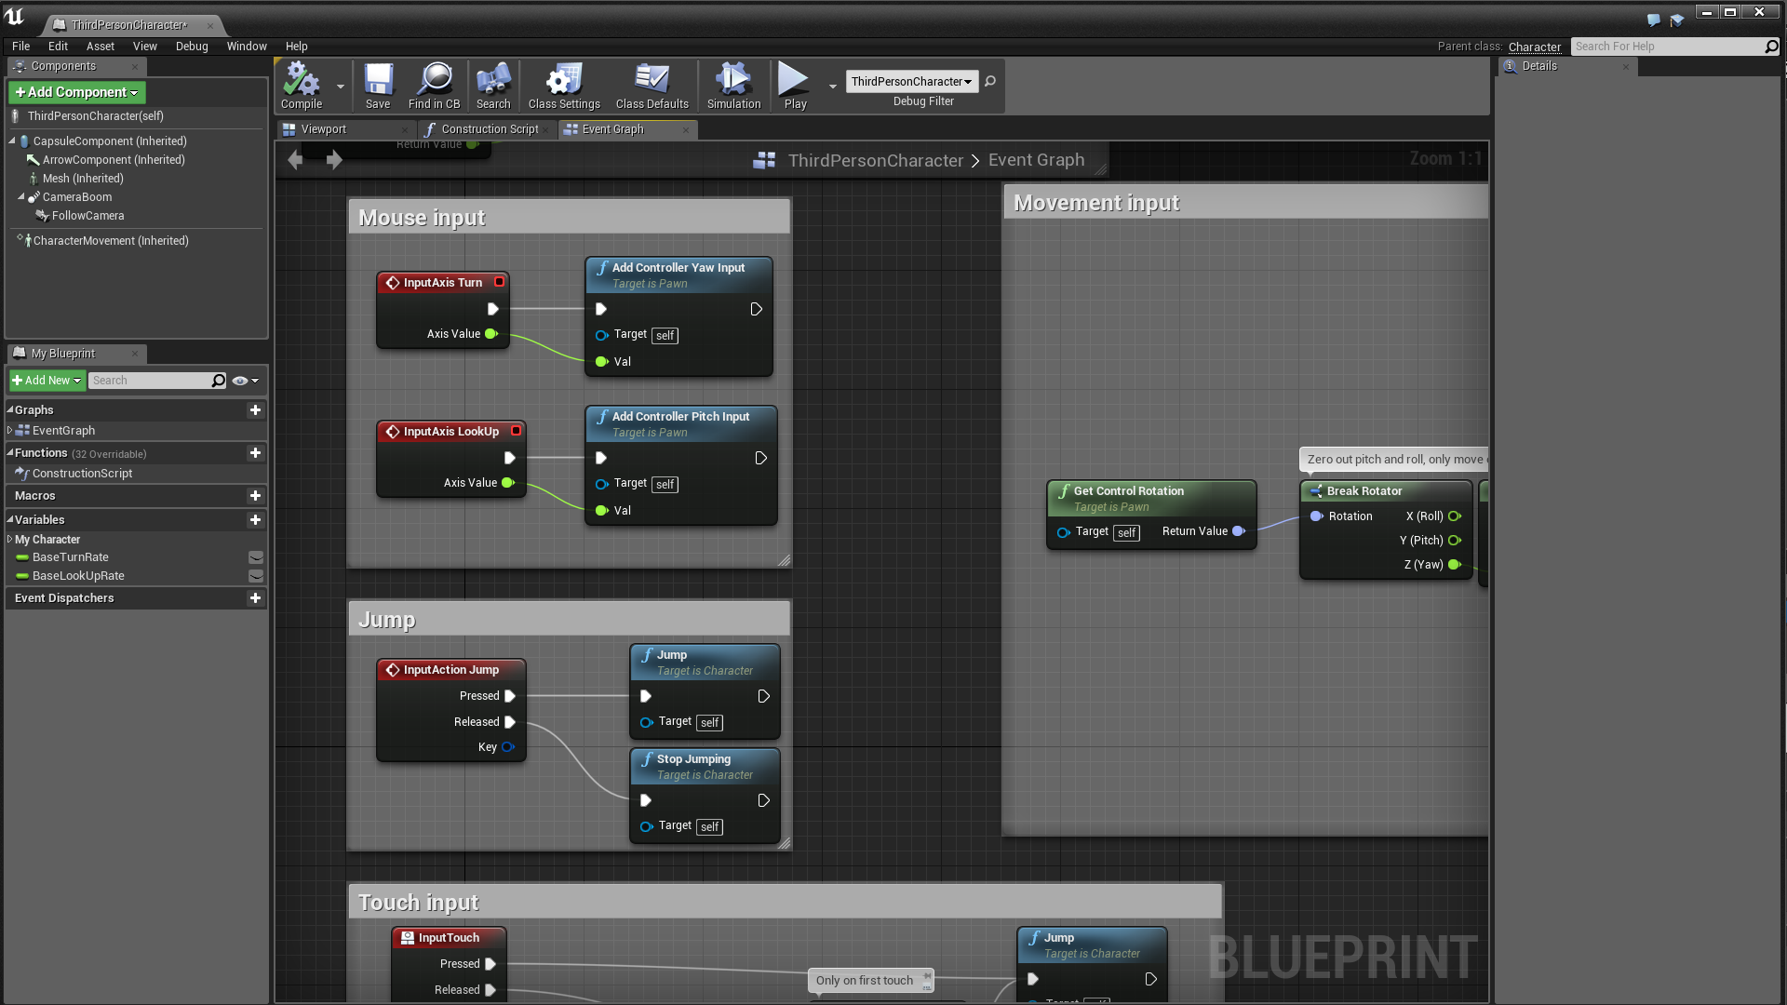
Blueprints
Visual scripting
Ultimately always subclasses of Engine C++ classes, & potentially your own C++ classes
Superclass C++ functions, object & global variables can be exposed to blueprint subclasses through C++ macros

Slide 5
C++ ➔ Blueprint Exposure Macros
Type | Description
UPROPERTY | Exposes global & object variables
UFUNCTION | Exposes functions
USTRUCT | Exposes structs
UENUM | Exposes enumerators

Slide 6
C++ ➔ Blueprint Exposure Specifiers
Relation | Macro | Description
Property Window | VisibleAnywhere | Read Access
Property Window | EditAnywhere | Read & Write Access
Blueprint | BlueprintReadOnly | Read Access
Blueprint | BlueprintReadWrite | Read & Write Access
UPROPERTY(VisibleAnywhere, BlueprintReadOnly)
class UMyClass* MyObject;

Slide 7
C++ & Blueprints Comparison
Type | Performance | Productivity (Short Term) | Productivity (Long Term) | Documentation | Scope | Transferability
C++ | High | Low | High | Lacking | All Features | Significant
Blueprints | Low | High | Low | Sufficient | Most Features | Insignificant

Slide 8
Data Types & Containers

Slide 9
Data Types
Purpose | Types | Dependency
Boolean | bool | C++
Integers | uint8, uin16, uint32, uint64, int8, int16, int32, int64 | Engine
Floating Point | float | C++
Characters | FString, FName, FText, TCHAR | Engine
Spatial Representation | FVector, FVector2D, FRotator | Engine
Enumerator | enum | C++ with UENUM() Macro

Slide 10
Unreal Engine Containers
TArray<float> myArray;
myArray.Add(10.f);
myArray.Remove(10.f);
TSet<float> mySet;
mySet.Add(10.f);
mySet.Remove(10.f); //Removes any element with a value of ‘10.f’
TMap<FString, float> myMap;
myMap.Add(10.f, TEXT(“Hello!”));
myMap.Remove(10.f); //Removes the element with a key of ‘10.f’

Slide 11
Classes

Slide 12
Creation & Deletion
Create C++ Project
No Editor support for deletion of classes
Navigate to Project Directory in File Explorer
Delete Header & CPP files in source directory
Delete everything in Binaries directory
Delete Intermediate & Saved directories
Generate Visual Studio project files
Right click UProject file ➔ show more options ➔ generate files
Run Visual Studio project
Rebuild project in Visual Studio

Slide 13
Default C++ Files
Name (Header & CPP Respectively) | Subclass of | Description
MyProject |  | Blank
MyProjectCharacter | ACharacter | Player character
MyProjectGameMode | AGameModeBase | Server instanced game state

Slide 14
Entities
Support | Mesh (Geometry of Entity) | Component (Composed into Actor) | Actor (Provides Spawnability)
Rendering |  | UMeshComponent | AActor
Synonymous to AActor | UStaticMesh | UStaticMeshComponent | AStaticMeshActor
Animation | USkeletalMesh | USkeletalMeshComponent | ASkeletalMeshActor
Possession |  |  | APawn
Collision & Movement |  |  | ACharacter
Notes:
UStaticMesh: A StaticMesh is a piece of geometry that consists of a static set of polygons.
UStaticMeshComponent: StaticMeshComponent is used to create an instance of a [UStaticMesh]
USkeletalMesh: SkeletalMesh is geometry bound to a hierarchical skeleton of bones which can be animated for the purpose of deforming the mesh.
USkeletalMeshComponent: SkeletalMeshComponent is used to create an instance of an animated SkeletalMesh asset.

Slide 15
ACharacter Class Components
Component | Class | Description
RootComponent TObjectPtr<USceneComponent> | AActor | Central component that all other components must be attached to. Entity transform (location, scale & rotation).
CapsuleComponent TObjectPtr<UCapsuleComponent> | ACharacter | Movement collision
Controller TObjectPtr<AController> | APawn | Possessor of entity
MyCameraComponent USpringArmComponent | ACharacter Subclass | Camera
CharacterMovement TObjectPtr<UCharacterMovementComponent> | ACharacter | Movement logic & modes
Mesh TObjectPtr<USkeletalMeshComponent> | ACharacter | Primary skeletal mesh of entity
Notes:
PlayerController: Player controls entity
AIController: AI controls entity
Controllers are by default 1-1 with entity, however this can be changed so controller can be mapped to multiple entities

Slide 16
Entity Functions

Slide 17
Inputs
Input controls (names & keybinds) defined in project settings in Editor
Input custom event functions bound in SetupPlayerInputComponent function
Bound inputs are stored in PlayerInputComponent object
Inputs can be bound either as actions or axes
Actions execute once upon input activation & support various input mechanisms
Axes perpetually execute while input is activated & therefore exclusively support input holding
void AMyCharacter::SetupPlayerInputComponent(class UInputComponent* PlayerInputComponent) {
PlayerInputComponent->BindAction("Jump", IE_Pressed, this, &AMyCharacter::Jump);
PlayerInputComponent->BindAxis("MoveForward", this, &AMyCharacter::MoveForward);
}

Slide 18
Collision
//Enable reflection with ‘UFUNCTION()’ macro for ‘AddDynamic’ macro
UFUNCTION()
void OnCollision(UPrimitiveComponent* HitComponent, AActor* OtherActor, UPrimitiveComponent* OtherComp, FVector NormalImpulse, const FHitResult& Hit);
HitComponent The component of the actor that collided
OtherActor The actor that collided with the actor in reference
OtherComp The component of the actor that collided with the actor in reference
NormalImpulse The normal force of the collision (direction & magnitude)
Hit Extra information about the collision

Slide 19
Binding Events / Signatures
//Declaration (Engine source code)
DECLARE_DYNAMIC_MULTICAST_SPARSE_DELEGATE_FiveParams(FComponentHitSignature, UPrimitiveComponent, OnComponentHit, UPrimitiveComponent*, HitComponent, AActor*, OtherActor, UPrimitiveComponent*, OtherComp, FVector, NormalImpulse, const FHitResult&, Hit);
//Definition (Engine source code)
UPROPERTY(BlueprintAssignable, Category="Collision")
FComponentHitSignature OnComponentHit;
//Bind your function to ‘OnComponentHit’ signature/event
void AMyCharacter::BeginPlay() {
GetCapsuleComponent()->OnComponentHit.AddDynamic(this, &AMyCharacter::OnCollision);
}
Notes:
Delegates: Data types that reference and execute member functions on C++ Objects
Support: - Functions returning a value
- Functions declared as const
- Up to four "payload" variables
- Up to eight function parameters

Slide 20
Physics
//Using capsule component (relatively cheap):
MySkeletalMeshComponent->SetCollisionEnabled(ECollisionEnabled::QueryOnly);
MySkeletalMeshComponent->SetCollisionObjectType(ECollisionChannel::ECC_Pawn);
GetCapsuleComponent()->SetSimulatePhysics(false);
//Using skeletal mesh component to ragdoll character (relatively expensive):
MySkeletalMeshComponent->SetCollisionEnabled(ECollisionEnabled::QueryAndPhysics);
MySkeletalMeshComponent->SetCollisionObjectType(ECollisionChannel::ECC_PhysicsBody);
MySkeletalMeshComponent->SetAllBodiesBelowSimulatePhysics("myBone", newSimulate, includeSelf);
GetCapsuleComponent()->SetSimulatePhysics(true);

Slide 21
Movement
virtual void AddMovementInput(FVector WorldDirection, float ScaleValue = 1.0f, bool bForce = false) override;
virtual void OnMovementModeChanged(EMovementMode PrevMovementMode, uint8 PreviousCustomMode = 0) override; //For instance, the transition between walking & flying
virtual void Landed(const FHitResult& Hit) override;
virtual void Jump() override;
virtual void NotifyJumpApex() override; //Executes upon highest point during jump
virtual void StopJumping() override;

Slide 22
Graphical User Interfaces (GUIs)

Slide 23
GUI Types
Type | C++ & Blueprint Support | Abstraction | Productivity | Scope & Flexibility
Slate | C++ | Low | Low | High
UMG (Unreal Motion Graphics UI Designer) | Both | High | High | Low
Blog Tutorial on GUIs
https://benui.ca/unreal/ui-cpp-basics/

Slide 24
Procedural Meshes

Slide 25
Rendering & Unrendering
UProceduralMeshComponent* MyMesh; //Declaration
MyMesh->CreateMeshSection(sectionIndex, vertices, triangles, normals, UV0, vertexColours, tangents, createCollision); //Rendering of mesh
MyMesh->ClearMeshSection(sectionIndex); //Unrendering of mesh
YouTube Tutorial on Procedural Terrain Generation
https://www.youtube.com/watch?v=sNZ2g4qah28

Slide 26
Texturing
UPROPERTY(EditAnywhere) //Textures are set in the property window
UMaterialInterface* MyTextures;
UMaterialInstanceDynamic* MyTexture;
void UMyClass::MyFunction() {
MyTexture = UMaterialInstanceDynamic::Create(MyTextures, this);
MyProceduralMesh->SetMaterial(0, MyTexture); //At element index 0
}
YouTube Tutorial on Procedural Terrain Generation
https://www.youtube.com/watch?v=sNZ2g4qah28

Slide 27
Debugging

Slide 28
Console Logging
Type | Output
UE_LOG(LogTemp, Warning, TEXT(“Hello world!”)); | LogTemp: Warning: Hello world!
UE_LOG(LogTemp, Warning, TEXT(“myInt value: %d”), myInt); | LogTemp: Warning: myInt value: 64
UE_LOG(LogTemp, Warning, TEXT(“myInt value: %d | myFloat value: %f”), myInt, myFloat); | LogTemp: Warning: myInt value: 64 | myFloat value: 128.32
Wiki Tutorial on Logging
https://unrealcommunity.wiki/logging-lgpidy6i

Slide 29
Screen Logging
AddOnScreenDebugMessage(int32 Key, float TimeToDisplay, FColor DisplayColor, const FString& DebugMessage, bool bNewerOnTop, const FVector2D& TextScale)
Key Log message index (setting to another’s index will overwrite)
TimeToDisplay Time until message vanishes
DisplayColor Colour of text to display
DebugMessage Message to display
bNewerOnTop Whether to stack above still present older messages
TextScale Size of text
Wiki Tutorial on Logging
https://unrealcommunity.wiki/logging-lgpidy6i

Slide 30
Multithreading & Memory Management

Slide 31
UObject Initialisation
UObjects manage their own memory with the UE garbage collector
Use of the new & delete keywords is not permitted
The CreateDefaultSubobject & NewObject functions are used for initialisation
//Only for global & object variables & can only be done in constructor
MyComponent = CreateDefaultSubobject<UMyComponent>(TEXT("MyComponent"));
//All variable scopes & can be done anywhere with exception of in constructor
UMyObject* Item = NewObject<UMyObject>();

Slide 32
UObjects & UStructs
Type | Tangibility | Memory | Thread Access | Thread Safety
UObject | Saved to Drive | Managed (Garbage Collection) | Game Thread | N/A (Unsafe)
UStruct | Saved to Drive | Unmanaged | All Threads | Unsafe
Transient UObject | Not Saved to Drive | Unmanaged | All Threads | Unsafe

Slide 33
Smart Pointers
Type | Ownership | Deletion | Thread Safety
Shared Pointer | Shared | Indefinite | Optional
Shared Reference | Shared | Reference Stops Existing | Unsafe
Weak Pointer | False | Permissive | Unsafe
Unique Pointer | Private | Out of Scope | Unsafe
Thread Safe Shared Pointer Example
TSharedPtr<FMyStruct, ESPMode::ThreadSafe> NewPointer = MakeShared<FMyStruct, ESPMode::ThreadSafe>();
Notes:
Shared: indefinitely preventing deletion of that object, and ultimately handling its deletion when no Shared Pointer or Shared Reference (see below) references it. A Shared Pointer can be empty, meaning it doesn't reference any object.
Reference: Shared References must always reference a non-null object.
Weak: a Weak Pointer can become null at any time, without warning.
Unique: Unique Pointers can transfer ownership, but cannot share it.

Slide 34
Types of Multithreading
Type | Threads
Timer | Logical
Task Switch | Logical
Asynchronous Task | Real
Parallelisation | Real
Forum Tutorial on Various Multithreading Implementations
https://forums.unrealengine.com/t/multithreading-and-performance-in-unreal/1216417

Slide 35
Firing Timers
void SetTimer(FTimerHandle& InOutHandle, UserClass* InObj, typename FTimerDelegate::TMethodPtr< UserClass > InTimerMethod, float InRate, bool InbLoop = false, float InFirstDelay = -1.f)
InOutHandle Timer to activate
InObj Object to activate timer upon
InTimerMethod Function to execute upon timer completion
InRate Timer length (using <= 0.f clears all timers)
InbLoop True to fire at rate intervals, false to fire once
InFirstDelay Initial delay for rate interval timer (using < 0.f uses inRate value)

Slide 36
Using Timers
FTimerHandle MyTimer;
void AMyCharacter::MyFunction() {
if (GetWorldTimerManager().IsTimerActive(MyTimer) == false) {
GetWorldTimerManager().SetTimer(MyTimer, this, &AMyCharacter::MyDelayedFunction,
inRate, inbLoop, inFirstDelay);
}
}
void AMyCharacter::MyDelayedFunction() {
GetWorldTimerManager().ClearTimer(MyTimer);
}

Slide 37
Task Switching
FMyNonAbandonableTaskSubclass* Task;
UMyClass::StartTask() { //Task switch to your own function in the task object
Task->TaskSwitchFunction(this);
}
FMyNonAbandonableTaskSubclass::TaskSwitchFunction(UMyClass* MyClassIn)
MyClassIn->GenericFunction(); //Call any function within the task & scope
}

Slide 38
Asynchronous Tasks
AsyncTask(ENamedThreads::AnyBackgroundThreadNormalTask, [this] {
this->AsynchronousFunction();
});

Slide 39
Parallelised Asynchronous Tasks
Uses asynchronous tasks
Equivalent of serial for loop
Variable order of execution
arrayCount is elements within array, & brings everything from outside into scope & index is loop index
int testVar = 0; int arrayCount = 8;
ParallelFor(arrayCount, [&](int index) {
testVar = testVar + index;
index++; //Won’t increment linearly, since order of execution is variable
});

Slide 40
Multithreaded UObject Memory Management
FGCScopeGuard GCGuard; //Prevention of garbage collector (GC) running within its scope
UMyObject* TransientObject; { //Creation of transient object
TransientObject = NewObject<UMyObject>(GetTransientPackage(),
MakeUniqueObjectName(GetTransientPackage(), UMyObject::StaticClass(),
TEXT("TransientObject")), RF_Transient | RF_TextExportTransient | RF_DuplicateTransient);
}
/* Make use of ‘TransientObject’ in between */
AsyncTask(ENamedThreads::GameThread, [TransientObject]() mutable { //Movement to game thread
TransientObject->ClearInternalFlags(EInternalObjectFlags::Async); //Removal of ‘async’ flag to resume GC
});
Blog Tutorial on UObject Creation in Async Threads
https://voithos.io/articles/creating-uobjects-from-async-threads/

